Slide 1
 | 1
 |  | 2
 |  |  | 3
 |  |  |  | 4
 |  |  |  |  | 5

Slide 2
 |  | x_{C} | x_{R}
 |  | x_{B}
x_{current}
-
x_{right}
Result_{a} =
x_{current}
-
x_{below}
Result_{b} =

Slide 3

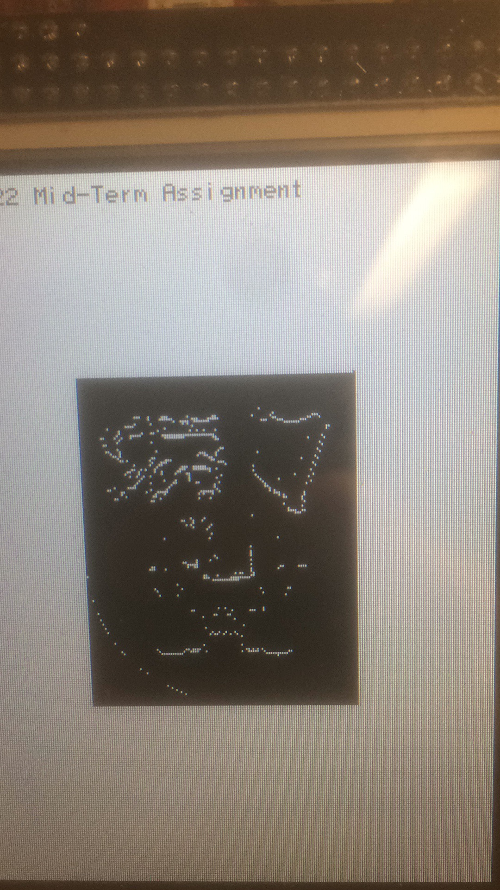
Original Image
Adjusted Image

